Slide 2
The External Economic Action of the European Union and the Sustainable Development Goals
Filippo Fontanelli – University of Edinburgh – filippo.fontanelli@ed.ac.uk
University of Bologna
3 May – 25 May
18 May 2023
Improving supply chains

Slide 3
Outline of the module (in progress)
The course’s basic coordinates
  Trade law, investment law and sustainable development: basic notions
  EU competences and policies in trade and investment law
Trade/investment obligations and non-trade values: the return of unilateralism
  The backlash against investor-State arbitration.
  The backlash against trade liberalisation
  Reform proposals for the global investment and trade regimes
  An overview of re-nationalisation trends in trade an investment (US, EU, UK, China)
    Anti-coercion
    Anti-circumvention
    Retaliate against non-MPIA
    Steel row, now sustainable
EU’s external economic action to raise standards abroad
  Free trade agreements and non-economic standards
    Conflict mineral regulation (sort of like diamonds)
    2022 commitment to green trade partnership
    Deforestation MERCOSUR
  Zoom-in: EU dispute with Korea on labour rights
  Zoom-in: level playing field and sustainable development in the Trade and Cooperation Agreement between the EU and the UK
    Mirror clauses
The Carbon Border Adjustment Mechanism
  Overview and assessment of the scheme
  Compatibility with WTO law (China’s complaint at WTO)
  Bonus: carbon removal
Energy (trade)
  EU Net Zero Industry Act and support to renewable energy industry (with assessment of WTO compatibility)
  Reaction to comparable foreign plans (US IRA)
  Zoom-in: biofuels and e-fuels
Energy (investments)
  Foreign investment protection and the fossil fuels industry
  Foreign investment protection and the nuclear energy industry
  Foreign investment protection and the renewable energy industry
  The Energy Charter Treaty, its reform attempts and the withdrawal of EU MS
Controlling trade and investment inbound and outbound flows
  Export restrictions and export controls (including coordinated action with US)
  Critical Raw Materials Act
  EU investment screening
Improving supply chains’ sustainability
  Friend-shoring and sustainable value chains
  Global supply chain due diligence proposal
  EU Guidance to Combat Forced Labor in Supply Chains
  Responsible forestry proposal (trade in forest-risk commodities)
  WTO law-compatibility of these schemes
Promotion of other social interests
  Non-paper of the Commission services 2017 TSD chatpers
  Gender balance in corporate governance in FTAs
  Protection of indigenous peoples’ rights
UNA Europa presentation

Slide 4


Slide 5


Outline
  Friend-shoring and sustainable value chains
  Global supply chain due diligence proposal
  EU Guidance to Combat Forced Labor in Supply Chains
  Responsible forestry proposal (trade in forest-risk commodities)
  WTO law-compatibility of these schemes
UNA Europa presentation

Slide 6
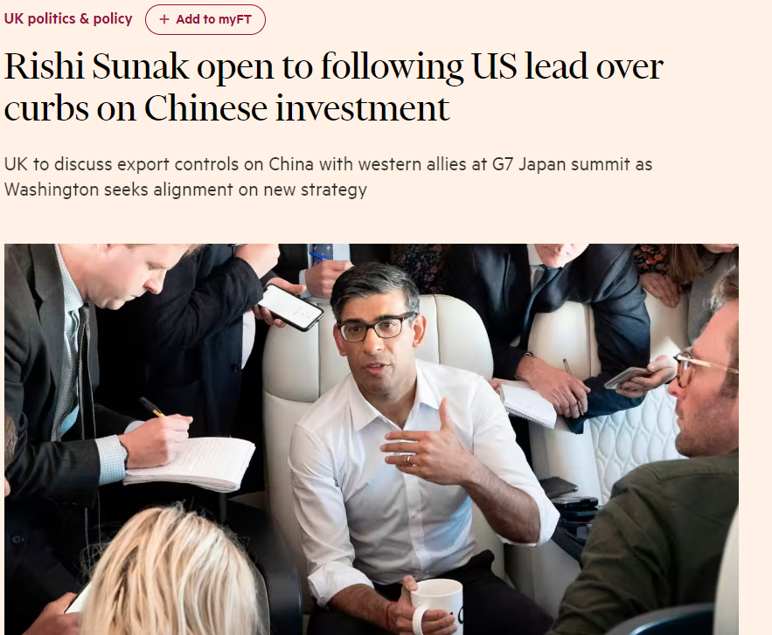
What’s going on?
UNA Europa presentation

Slide 7
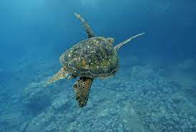
Intro: extra-territoriality?
Classic objections
Reading Article XX
PPMs
Prison labour
Same conditions prevail

Slide 8

Classic case-study: trade in seals
Appeal to morality
Problem of sub-exceptions under Article XX GATT
Regulatory alignment

Slide 9
Exporting values?

Slide 10

Value chains responsibility-sustainability

Slide 11
Due Diligence and CSR
This Directive is aimed at ensuring that undertakings under its scope operating in the internal market fulfil their duty to respect human rights, the environment and good governance and do not cause or contribute to potential or actual adverse impacts on human rights, the environment and good governance through their own activities or those directly linked to their operations, products or services by a business relationship or in their value chains, and that they prevent and mitigate those adverse impacts.

Slide 12

Scope of application: size and industry
  Directive applicable to companies with more than EUR 150 Mln turnover and 500 employees)
  also to companies with more than EUR 40 Mln turnover and 250 employees in certain high-risk sectors
  Non-EU: no employers threshold (but worldwide turnover)
UNA Europa presentation

Slide 13

Corporate duties
Integrating due diligence into corporate processes;
Identifying and assessing adverse human rights and environmental impacts;
Preventing, ceasing or minimizing actual and potential adverse human rights, and environmental impacts;
Assessing the effectiveness of measures;
Communicating;
Providing remediation.
UNA Europa presentation

Slide 14
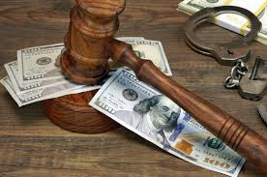
Penalties
Liability for damages
Fines (5% of worldwide turnover?)
Exclusion from government procurement
UNA Europa presentation

Slide 15
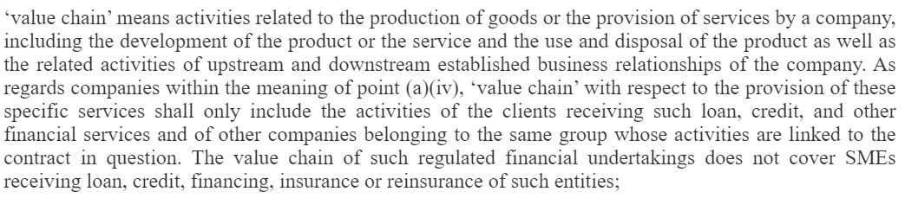
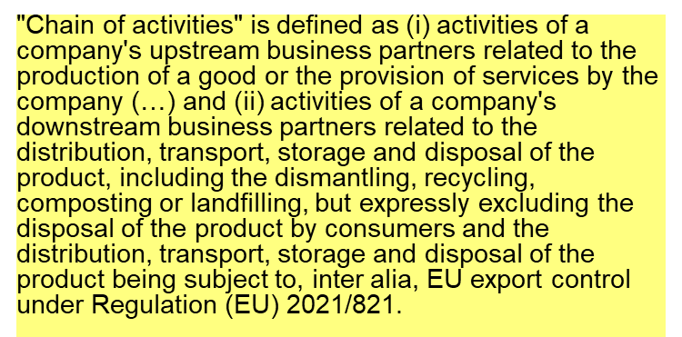
Value chain vs. Chain of activities
UNA Europa presentation

Slide 16
Reactions?
UNA Europa presentation

Slide 17
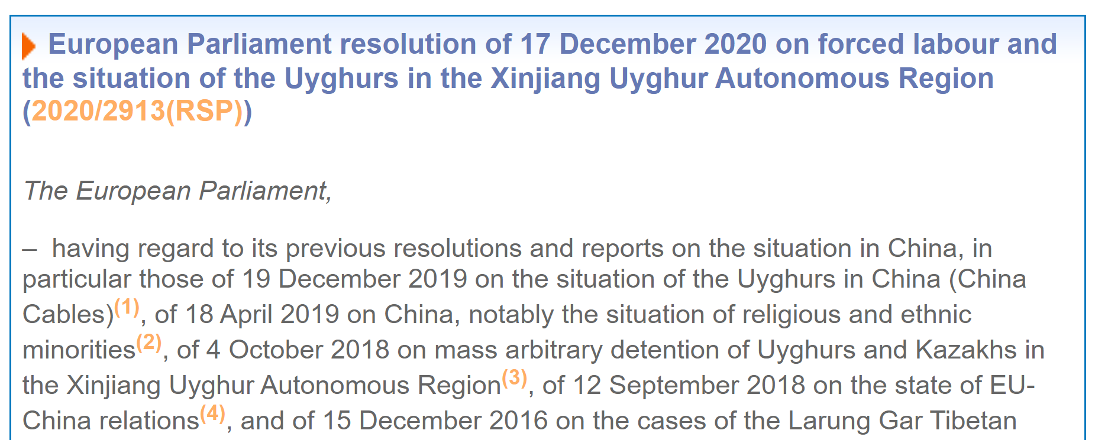
Forced labour initiative
UNA Europa presentation

Slide 18
Forced labour initiative
UNA Europa presentation

Slide 19
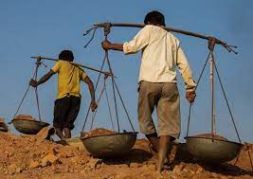
Commission proposal September 2022
All products available on EU market (domestic or imported).
No distinction by sector or size.
MS responsible for the investigation, determination, enforcement and withdrawal and fines.
Customs authorities would block non-complying goods at EU borders.
    * Complementary to DD regulation: only labour, no eligibility, no DD over supply chains, outright prohibition
https://mostfavourednation.substack.com/p/most-favoured-nation-forced-labour?
UNA Europa presentation

Slide 20

Forestry regulation - coverage
Beef Cocoa Coffee Palm oil Soy Wood
Processed products such as leather, chocolate, and furniture.
Goods selected through a “thorough scientific and cost-benefit analysis of their impact on deforestation” (EU statement to Committee on Trade and Environment)
UNA Europa presentation

Slide 21
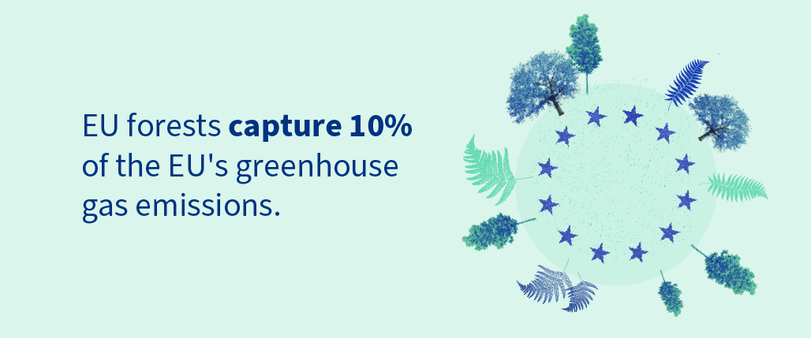
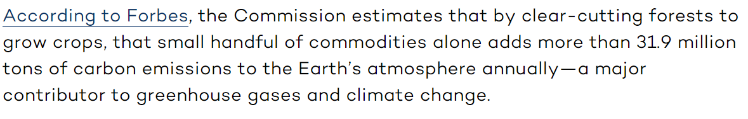
Rationale of forestry regulation

Slide 22
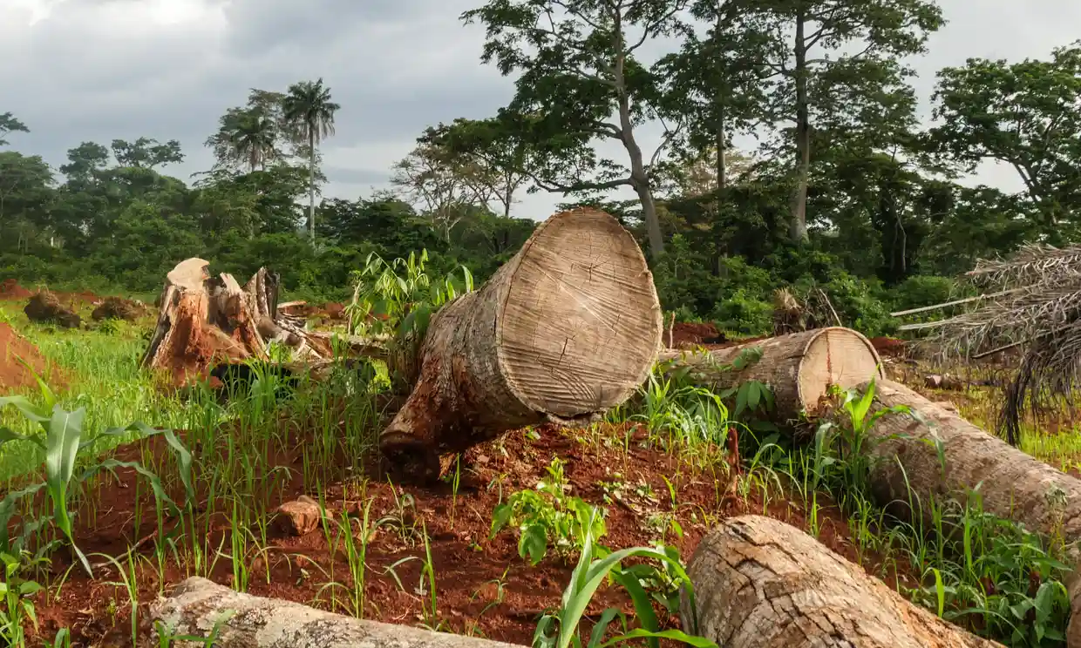
Forestry regulation
Block entry of deforestation goods into the EU market.
Conditions:
deforestation-free
produced in accordance with the domestic legislation
due diligence statement.
UNA Europa presentation

Slide 23

Contestation
Developing countries ‘said that any sustainability initiatives should consider the, especially thoseneeds and capacities of developing countries that have suffered massive deforestation in the past.’
A benchmarking system assigns to EU and non-EU countries a level of risk related to deforestation and forest degradation.
The risk category is used to determine the level of specific obligations for operators and member states’ authorities to carry out inspections and controls.
UNA Europa presentation

Slide 24
Benchmarking criteria
rate of deforestation and forest degradation;
rate of expansion of agriculture land for relevant commodities;
production trends of relevant commodities and of relevant products.
Info on covering of emissions and removals from agriculture, forestry and land use in the national UNFCCC goals
Commodities deals with EU;
Domestic anti-deforestation measures;
Transparency and HR compliance.
UNA Europa presentation

Slide 25

Discrimination? Three angles
CBDR, but also
Country benchmarks used to set frequency of checks:
on 9% of operators and traders trading products from high-risk countries,
3% from standard-risk countries
1% from low-risk countries
in order to verify that they effectively fulfil the obligations laid down in the regulation.
Product selection
UNA Europa presentation

Slide 26
WTO legality?
Basic principle
Like products should be treated the same irrespective of origin
MFN
NT
Justification
Resource-related aim
Accompanied by domestic equivalent measures?
Do the ‘same conditions prevail’ in the differently benchmarked countries?
UNA Europa presentation

Slide 27
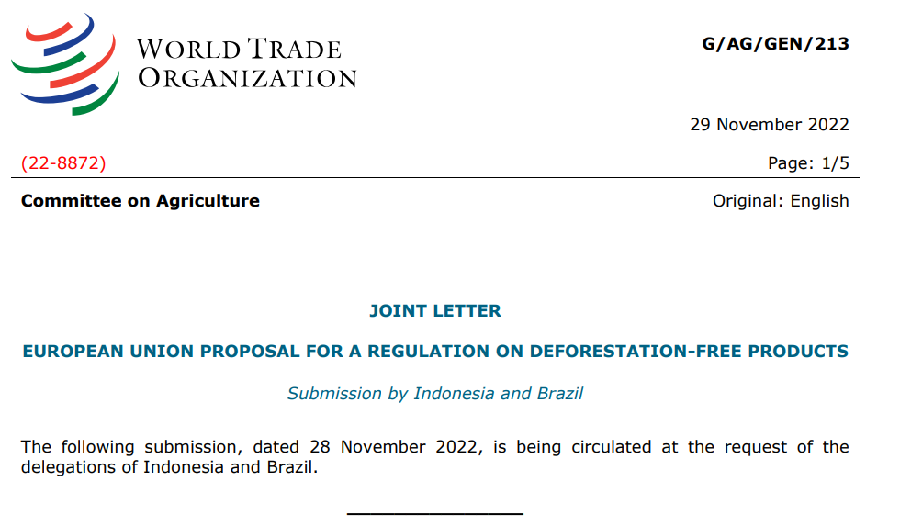
Indonesia and Brazil - comments
UNA Europa presentation

Slide 28
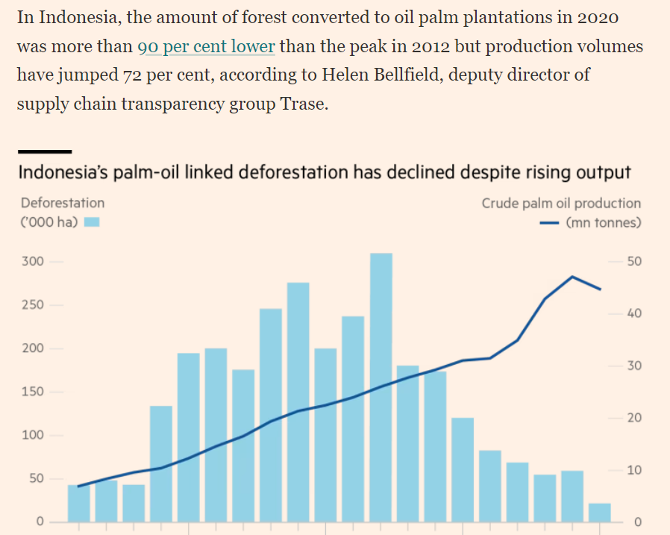
Effective?
UNA Europa presentation

Slide 29

Effective? Spill-over on non-forestry
UNA Europa presentation

Slide 30
Emulation?
UNA Europa presentation

Slide 31
@una_europa
#Una_Europa
Thanks!

